Slide 1


The Freedom Paradox
John 6:66-69
July 5, 2026

Slide 2

Paradox
The
Freedom
Paradox
idea, principle, or fact
that seems to contradict itself
but is actually true

Slide 3

Passage
The
Freedom
Paradox
John 6:66-69
July 5, 2026

Slide 4
Apprehending the
Freedom Paradox
The
Freedom
Paradox
July 5, 2026

Slide 5
The Freedom Paradox
The
Freedom
Paradox
True freedom is not independence
freedom ≠ independence
True freedom is in dependence
freedom
dependence

Slide 6
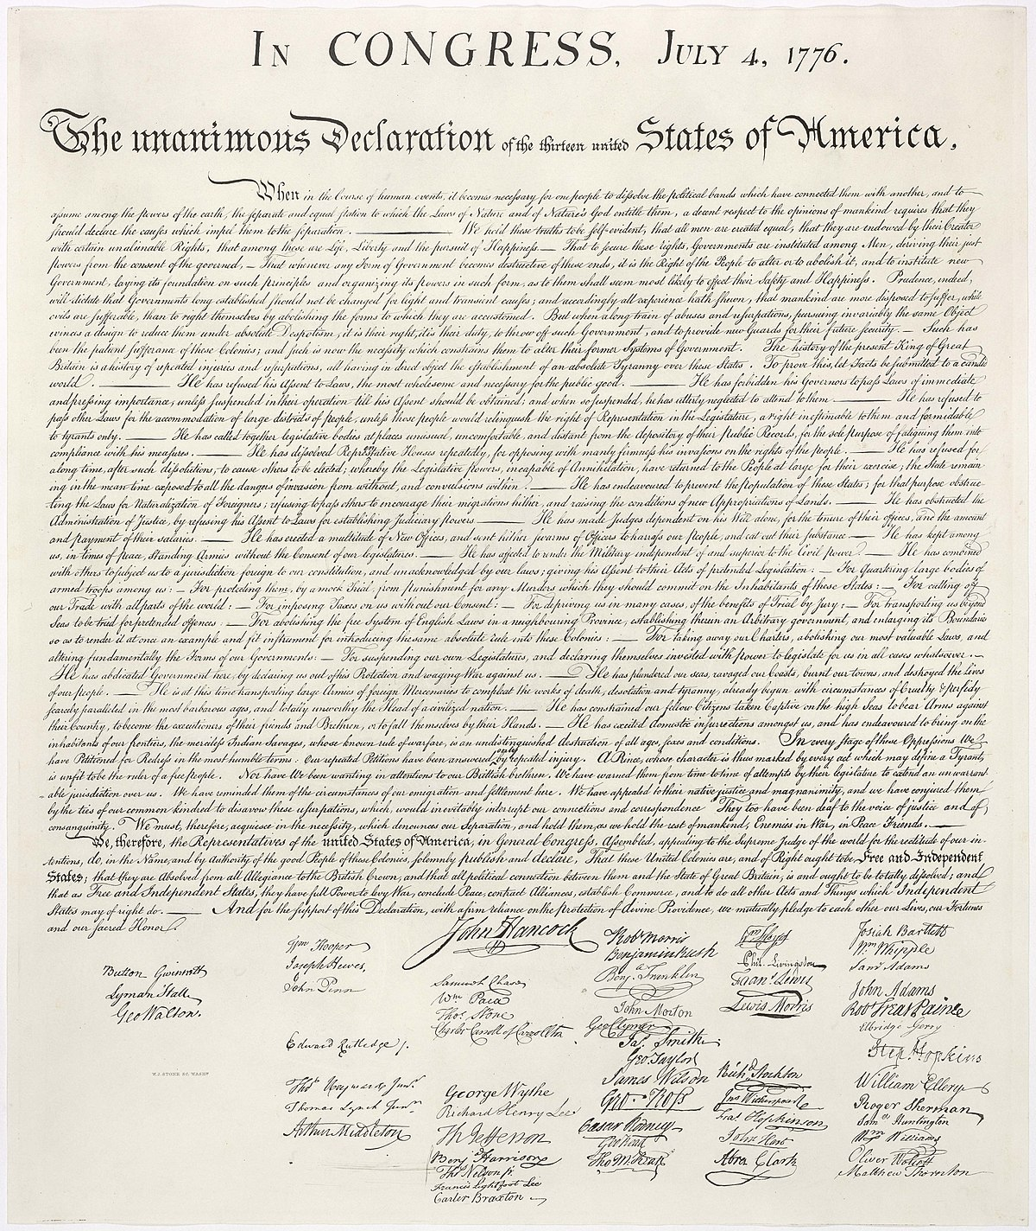
The
Freedom
Paradox

Slide 7
The
Freedom
Paradox

Slide 8


The
Freedom
Paradox

Slide 9





The
Freedom
Paradox

Slide 10
The Freedom Paradox
The
Freedom
Paradox
True freedom is not independence
True freedom is in dependence

Slide 11
Applying the
Freedom Paradox
The
Freedom
Paradox
July 5, 2026

Slide 12
Applying the
Freedom Paradox
The
Freedom
Paradox
Make Eternal Life Your Overriding Priority
July 5, 2026

Slide 13
ephemeral
The
Freedom
Paradox
Something that only lasts a very short time
ephemeral life
A limited, uncertain existence

Slide 14
Eternal Life
The
Freedom
Paradox
Life in the presence, power, and
promise of God
Without limitations and without end

Slide 15
Applying the
Freedom Paradox
The
Freedom
Paradox
Make Eternal Life Your Overriding Priority
Recognize Jesus Christ as
the Source and Resource
of Eternal Life
July 5, 2026

Slide 16
Applying the
Freedom Paradox
The
Freedom
Paradox
Make Eternal Life Your Overriding Priority
Recognize Jesus Christ as
the Source and Resource
of Eternal Life
Trust Jesus Christ to Experience Eternal Life
July 5, 2026

Slide 17
In Christ we are free
The
Freedom
Paradox
From…
…the law of sin and death
…condemnation to bear the penalty of our sin
…fear of being separated from the love of God
For…
…eternal life
...transformation
…open eternal access to god’s presence and favor
...a full share in his promise
…full inclusion in the people of god
…holiness and holy living
…life with purpose
…victory
…fellowship and ministry in his body, the church
…revelation and understanding

Slide 18
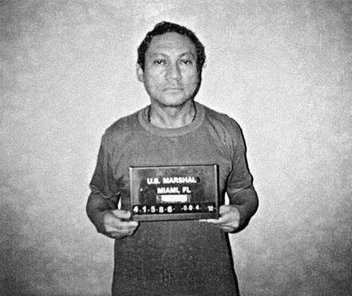
The
Freedom
Paradox

Slide 19
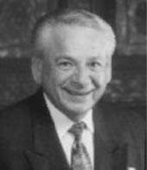

The
Freedom
Paradox

Slide 20
The Freedom Paradox
The
Freedom
Paradox
True freedom is not independence
True freedom is in dependence

