Slide 1
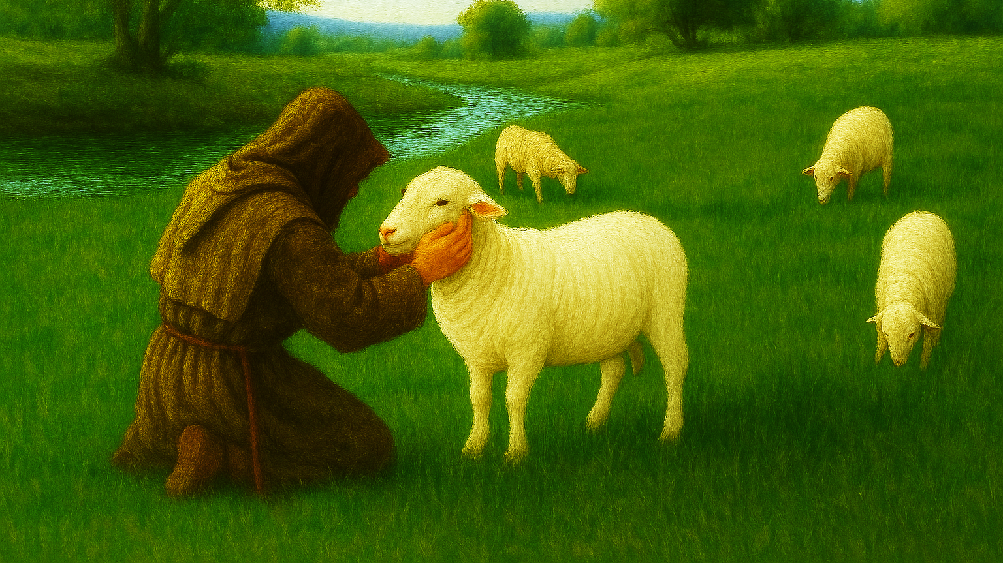

my SHEPHERD
my SECURITY
March 1, 2026

Slide 2
“Yea, though I walk through the valley of the shadow of death, I fear no evil, for Thou art with me.”
What does this say?
“Yea, though” = “Truly, when”

Slide 3
“Yea, though I walk through the valley of the shadow of death, I fear no evil, for Thou art with me.”
What does this say?
“Yea, though” = “Truly, when”
“walk through”, not merely into

Slide 4
“Yea, though I walk through the valley of the shadow of death, I fear no evil, for Thou art with me.”
What does this say?
“Yea, though” = “Truly, when”
“walk through”, not merely into
“valley”: deep gorge or canyon

Slide 5
“Yea, though I walk through the valley of the shadow of death, I fear no evil, for Thou art with me.”
What does this say?
“Yea, though” = “Truly, when”
“walk through”, not merely into
“valley”: deep gorge or canyon
“shadow of death”: death-shadow

Slide 6
“Yea, though I walk through the valley of the shadow of death, I fear no evil, for Thou art with me.”
What does this say?
“evil”: wickedness or harm

Slide 7
“Yea, though I walk through the valley of the shadow of death, I fear no evil, for Thou art with me.”
What does this say?
“evil”: wickedness or harm
“fear no” I don’t fear when
I encounter wickedness or harm

Slide 8
“Yea, though I walk through the valley of the shadow of death, I fear no evil, for Thou art with me.”
What does this say?
“evil”: wickedness or harm
“fear no” I don’t fear when
I encounter wickedness or harm
“for Thou art with me”: because
You are with me

Slide 9
“Yea, though I walk through the valley of the shadow of death, I fear no evil, for Thou art with me.”
What does this say?
Important Transition:
“He” → “You”

Slide 10
“Yea, though I walk through the valley of the shadow of death, I fear no evil, for Thou art with me.”
What does this say?
“Indeed, when I walk through death-shadow valley,
I fear not evil or harm
because You are with me.”

Slide 11
“Indeed, when I walk through death-shadow valley, I fear not evil, because You are with me.”
What does this reveal?
You will experience suffering.

Slide 12
“Indeed, when I walk through death-shadow valley, I fear not evil, because You are with me.”
What does this reveal?
You will experience suffering.
Your suffering is temporary.

Slide 13
“Indeed, when I walk through death-shadow valley, I fear not evil, because You are with me.”
What does this reveal?
You will experience suffering.
Your suffering is temporary.
Your SECURITY is conditional.

Slide 14
“Indeed, when I walk through death-shadow valley, I fear not evil, because You are with me.”
What does this reveal?
“Truly, when I walk through dark times of suffering in death-shadow valleys, I do not fear evil or harm I encounter there, because You, my LORD SHEPHERD, are my SECURITY, ever with me.”

Slide 15
“Indeed, when I walk through death-shadow valley, I fear not evil, because You are with me.”
What does this require?
Trust the SHEPHERD.

Slide 16
my SHEPHERD
my SECURITY
March 1, 2026

