Slide 1
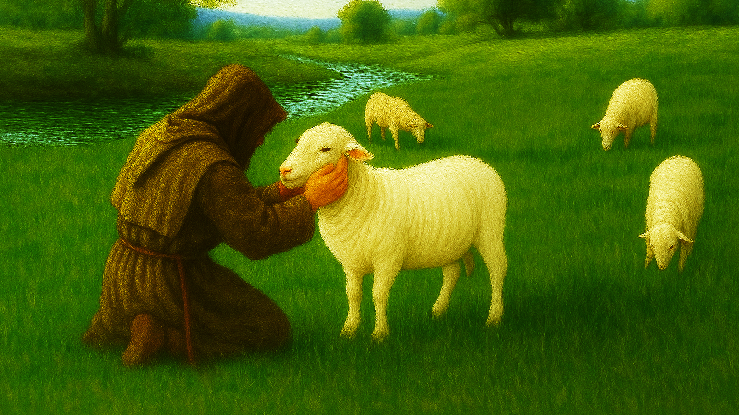

my SHEPHERD
my HELP
March 15, 2026

Slide 2
“Thou preparest a table before me in the presence of mine enemies.”
What does this say?
“a table” - furniture: flat surface on
vertical legs
for meals
for worship

Slide 3
“Thou preparest a table before me in the presence of mine enemies.”
What does this say?
“preparest” = arrange
“before me” = face
“in the presence” = in full view

Slide 4
“Thou preparest a table before me in the presence of mine enemies.”
What does this say?
“of mine enemies”: bind or tie up
both adversaries and adversities

Slide 5
“Thou preparest a table before me in the presence of mine enemies.”
What does this say?
“Thou” LORD YHWH, my SHEPHERD
Creator, LORD Almighty,
our Strong Deliverer,
the Great and Awesome Living GOD, Eternal King of Glory
Whose Sovereignty rules over all

Slide 6
“Thou preparest a table before me in the presence of mine enemies.”
What does this say?
“Thou” LORD JESUS
“YOU, LORD YHWH, my SHEPHERD,
set out in front of me a royal, sacred feast in the full view of all my adversaries and adversities.”

Slide 7
“You set out in front of me a royal, sacred feast in the full view of my adversaries and adversities”
What does this reveal?
my SHEPHERD’s table is where He gives me HIS HELP
Kindness
Reconciliation

Slide 8
“You set out in front of me a royal, sacred feast in the full view of my adversaries and adversities”
What does this reveal?
my SHEPHERD’s table is where He gives me HIS HELP
Kindness
Reconciliation
Refuge

Slide 9
“You set out in front of me a royal, sacred feast in the full view of my adversaries and adversities”
What does this reveal?
my SHEPHERD’s table is where He gives me HIS HELP
Kindness
Reconciliation
Refuge
Presence

Slide 10
“You set out in front of me a royal, sacred feast in the full view of my adversaries and adversities”
What does this reveal?
“YOU, LORD YHWH, my SHEPHERD,
are my HELP, for YOU set out in front of me a royal, sacred feast and are right here with me at YOUR table in the full view of all my adversaries and adversities.”

Slide 11
“You set out in front of me a royal, sacred feast in the full view of my adversaries and adversities”
What does this require?
Trust the SHEPHERD.
Seek His HELP.

Slide 12
“You set out in front of me a royal, sacred feast in the full view of my adversaries and adversities”
What does this require?
Trust the SHEPHERD.
Seek His HELP.
Accept His HELP.

Slide 13
YOU, LORD YHWH, my SHEPHERD, YOU, YOU YOURSELF, YOU are my HELP, for YOU set out in front of me a royal, sacred feast and are right here with me at YOUR table in the full view of my adversaries and adversities whom I no longer even see because my attention is fully and completely filled with YOU, LORD YHWH, my SHEPHERD, my HELP

Slide 14
my SHEPHERD
my HELP
March 15, 2026

